Slide 1
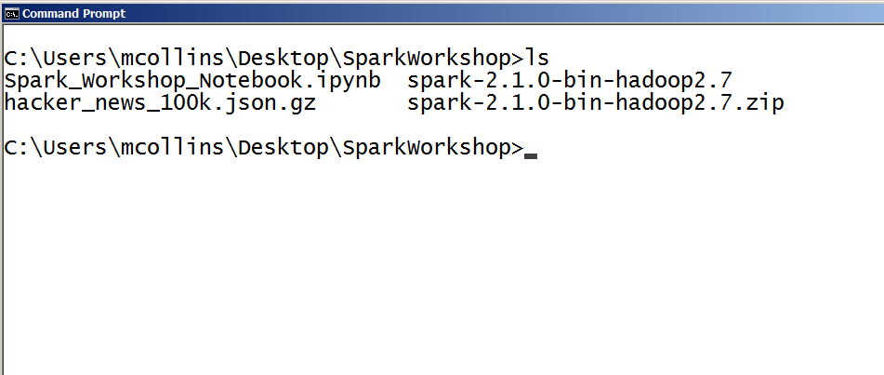
Today’s Dataset and Notebook
http://elk.acis.ufl.edu/Spark-Workshop/
Spark_Workshop_Notebook.ipynb
data/hacker_news_100k.json.gz

Slide 2



Getting Started with Apache Spark
Welcome to UF DSI!

Slide 3


Your Tour Guide
Matthew Collins
Technical Operations Manager
Advanced Computing and Information Systems Laboratory
mcollins@acis.ufl.edu
https://acis.ufl.edu/

Slide 4
Goals for this workshop:
Why Apache Spark?
How does Spark relate to Hadoop and Python?
Basic Spark DataFrame syntax
Running analyses - yours and Spark ML
Presenting data from Spark
Portability/scalability of Spark jobs
Notes:
There are a lot of introductions to Spark that start with descriptions of the internals. I wanted this introduction to come from the direction of demonstrating how it feels to use Spark. We’re not going to talk about distributed computing theory or how data structures are managed. The Wikipedia page has a quick overview of that sort of thing and it’s a nice read if you already know a lot of CS terms.

Slide 5
Why ?
What can it do for me?
How does it relate to Hadoop?
And what are Spark and Hadoop anyway?
Notes:
Why would you want to spend time learning Spark?
I’ll look at each of these questions in the reverse order.

Slide 6







First: What is “Hadoop”?
A framework which is a synonym for lot of stuff that works together...
But probably most people mean:
The whole ecosystem: https://hadoopecosystemtable.github.io/
Notes:
Let’s start with a description of what “hadoop” is. Hadoop is a collection of open source software projects supported by the Apache Foundation written to do distributed data processing and storage on many commodity computers. Private companies (HortonWorks, Cloudera) bundle and distribute this software:
storage systems (HDFS, Hbase)
query & storage engines (Hive)
computation engines (MapReduce)
workflow (oozie)
machine learning (mahout)
streaming (Storm)
Spark is perhaps most frequently discussed as a replacement for MapReduce but it does much more - in fact it does a lot of what is shown here.
But it’s complicated. Many of these tools use each other and many are modular and can be exchanged. For example, Spark includes a ML API that implements common algorithms which are faster than Mahout’s implementation on MapReduce. So, Mahout is moving to using Spark instead of MapReduce. Many people store data for Spark in HDFS or Hive.

Slide 7
Distributed Processing Engines
Spark and MapReduce are distributed parallel data processing engines:
Run on multiple computers
Manages parallelizing your tasks
Manages data locality during execution
Are not programming languages - they run jobs you write in a programming language
Notes:
Can anyone think of something else that works this way? That Kyle talked about in the SQL workshop? How about a SQL database server - it is a process that handles running code written in SQL - it also handles data storage which Spark and MapReduce rely on other tools to do for them (local files, HDFS, ElasticSearch, Cassandra…)
It’s important to understand that Apache MapReduce is an implementation of the map-reduce method of computation. When we talk about map-reduce in Spark, we’re not talking about the Apache MapReduce software that is part of the Hadoop ecosystem.

Slide 8
What can these things do?
Map - reduce pattern calculations: perform an analysis of data local to a machine, set results back for aggregation
Machine learning: Spark can do iterative algorithms – ALS etc
Graph calculations - GraphX
Stream processing - online learning
Scale! Thousands of nodes!
Notes:
The Wikipedia overview really isn’t too bad - if you already know some CS terms.

Slide 9
Now, why Spark?
Amazingly easy way to parallelize your analysis
Same code scales from laptops to clusters
MUCH easier to write than Hadoop M-R ever was
MUCH easier to deploy at all scales
And of course, it’s fashionable!

Slide 10
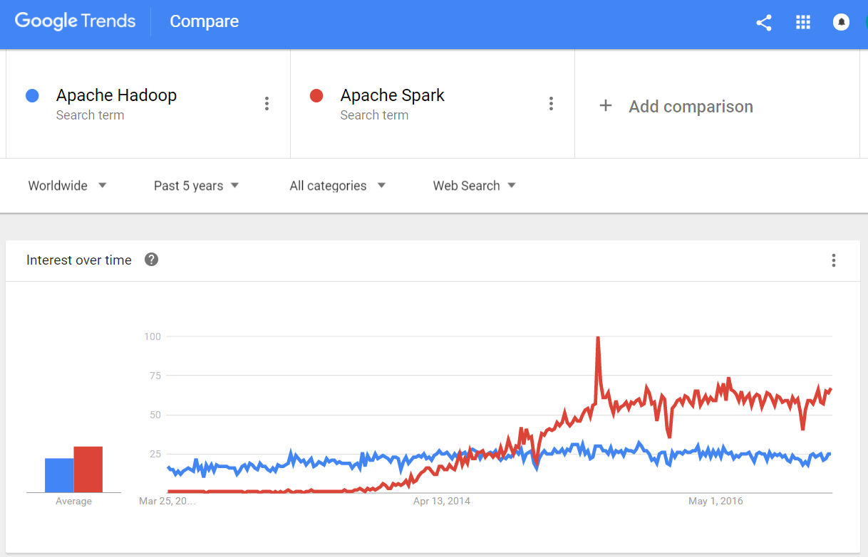
https://trends.google.com/trends/explore?q=Apache%20Hadoop,Apache%20Spark
Notes:
Notice here that Spark only takes off mid 2014 - it was made a top-level Apache project in February 2014. 1.0 release was in May 2014.

Slide 11
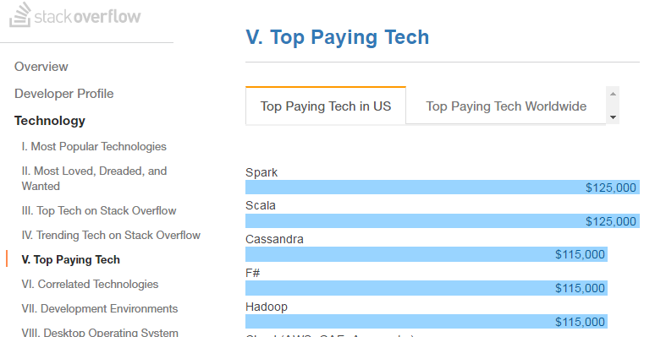
http://stackoverflow.com/research/developer-survey-2016#technology-top-paying-tech
Notes:
So let’s start getting in to Spark...

Slide 12
Moving Pieces
Spark - Java program that runs on computers and accepts jobs
Scheduler - Runs on a cluster (usually) and starts Spark in response to submitted jobs
Programming Language - What you write jobs in (Scala, Python, R)
Spark API - Functions you use to tell Spark what to do using the native syntax of your programming language
Notes:
We’re going to gloss over the scheduler and cluster layers for now and talk only about Spark running on your local computers.

Slide 13
First Concept - The RDD
Resilient Distributed Dataset
The data structure that enables much of Spark’s magic!
in-memory collection of objects
distributed across all Spark processes
steps used to regenerate are saved so fault-tolerant
Notes:
Limited mostly by the size of the memory available on all computers in the cluster - not really designed to use disk space but there are techniques for RDD’s on disk.

Slide 14
Second Concept - The SQL API
The RDD is the core data structure Spark uses for computation.
But, people found it pretty low level to work with.
So, they introduced a limited SQL API that implements common SQL operations (select, where, group by) and uses RDDs internally

Slide 15
Third Concept - The DataFrame
SQL parsing was good but people like the DataFrame concept and Spark wanted add more features.
So, in March 2015 they added the DataFrame data structure and functions to the SQL API (which remember, is based on RDDs)
Notes:
Spark is evolving rapidy as more people use it and figure out what the easiest ways of expressing their ideas are.
We’re using DataFrames today for all our work but remember, you can seamlessly interact with the underlying RDD if you need to and you can express most of the DataFrame operations as SQL if you prefer.

Slide 16
Fourth Concept - Datasets
Object-oriented interface - now in preview status
(Remember that Spark has only been advertised and used for real for less than 2 years.)
https://databricks.com/blog/2016/01/04/introducing-spark-datasets.html
Notes:
This community is really smart and the performance and ease-of-use improvements are happening at an insane rate.

Slide 17
Using DataFrames
Let’s make a DataFrame from a JSON file
To the Jupyter notebook!
Notes:
To Jupyter Notebook

Slide 18
Word2Vec
Math with words!
Represent words as vectors in a high (but not too high) dimension such that similar words are pointing in similar directions*
* Their cosine distance is small
Notes:
To Jupyter Notebook

Slide 19
Word2Vec - Making Vectors
A very simple explanation:
For a corpus, find all unique words
Make a vector for each word with a single 1
Scan each document using a sliding window
To the vector of the word in the center of the window, add a little bit to each position that occurs in the window and subtract a little bit from a random sampling of those that don’t.
A MUCH better and approachable explanation:
http://mccormickml.com/2016/04/19/word2vec-tutorial-the-skip-gram-model/
Notes:
To Jupyter Notebook

Slide 20
Word2Vec – Uses
Synonyms
Clustering words into topics, common roots
Analogies (the infamous king – man + woman = king)
https://www.distilled.net/resources/a-beginners-guide-to-word2vec-aka-whats-the-opposite-of-canada/
https://www.quora.com/What-are-some-interesting-Word2Vec-results
Notes:
To Jupyter Notebook

Slide 21
Using Word2Vec
Let’s try some synonyms
To the Jupyter notebook!
Notes:
To Jupyter Notebook

Slide 22
Links
Iterative machine learning in Spark: https://www.mapr.com/blog/parallel-and-iterative-processing-machine-learning-recommendations-spark
Spark Python API Documentation:
http://spark.apache.org/docs/latest/api/python/
Company that employs Spark’s creator:
https://databricks.com/

